Slide 1

CORONAVIRUS ANALYSIS USING SQL
Presented By: Madavan S
Mentorness Data Analyst Intern
Batch – MIP-DA-11
Notes:
Links: https://pixabay.com/photos/coronavirus-contact-no-thank-you-4904507/

Slide 2


INTRODUCTION
The COVID-19 pandemic has significantly disrupted global health and economies, emphasizing the need for comprehensive data analysis.
Analyzing COVID-19 data is essential for understanding the virus's spread, identifying patterns, and aiding public health responses.
This project aims to explore and analyze a COVID-19 dataset to uncover valuable insights and trends using SQL techniques.
Leveraging data analytics during the COVID-19 crisis helps in formulating effective public health strategies and policy decisions.
Utilizing SQL queries, this project delves into various aspects of the COVID-19 data to provide a deeper understanding of the pandemic's dynamics
Notes:
Links:
https://pixabay.com/photos/nurse-stethoscope-medicine-2141808/

Slide 3





PROBLEM STATEMENT
Investigate the COVID-19 dataset to comprehend the extent and impact of the virus across different regions and over time.
Analyze the data to detect significant trends in confirmed cases, deaths, and recoveries, and understand how these metrics evolve monthly and yearly.
Perform detailed statistical analysis to compute averages, variances, and standard deviations, providing a quantitative understanding of the virus's spread and impact.
Derive actionable insights that can assist in understanding the virus's progression and guide future responses and preparedness strategies.

Slide 4

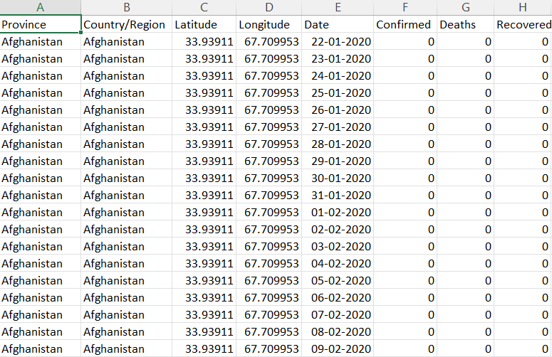
DATASET DESCRIPTION
Province: Geographic subdivision within a country/region.
Country/Region: Geographic entity where data is recorded.
Latitude: North-south position on Earth's surface.
Longitude: East-west position on Earth's surface.
Date: Recorded date of CORONA VIRUS data.
Confirmed: Number of diagnosed CORONA VIRUS cases.
Deaths: Number of CORONA VIRUS related deaths.
Recovered: Number of recovered CORONA VIRUS cases.
Notes:
Links:
https://pixabay.com/photos/nurse-stethoscope-medicine-2141808/

Slide 5
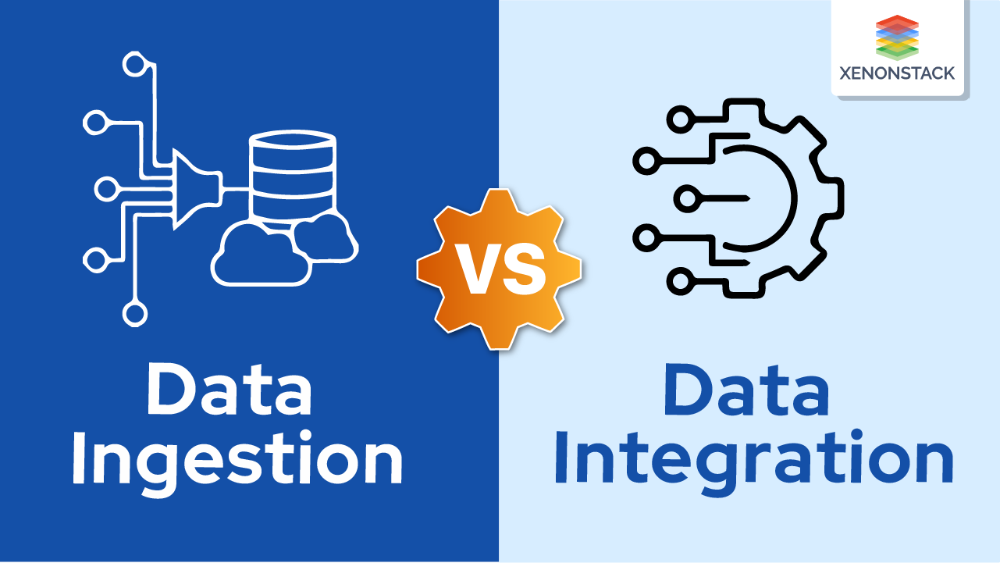
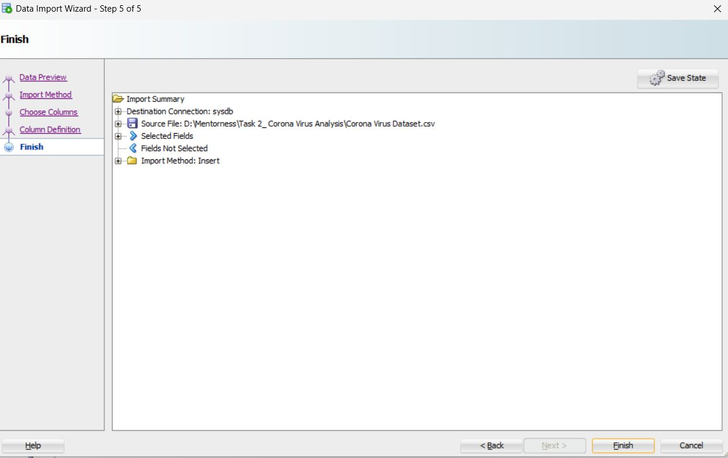
DATA INGESTION
Data Preview: Provides a snapshot of the CSV data, allowing you to review the content before importing.
Import Method: Selects how to load the data, such as creating a new table or appending to an existing one.
Choose Columns: Enables you to select which CSV columns to include in the table and their order.
Column Definition: Allows you to define each column's data type and attributes, ensuring they align with the CSV content.

Slide 6
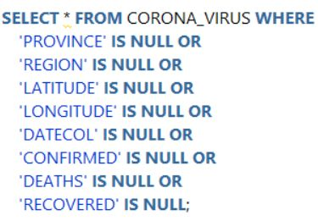

Q1. Write a SQL Query to check NULL values

Slide 7
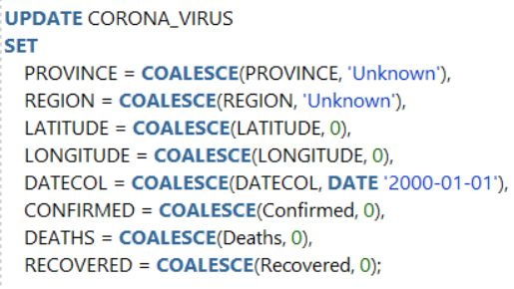

Q2. If NULL values are present, update them with zeros for all columns.

Slide 8

Q3. check total number of rows

Slide 9

Q4. Check what is start_date and end_date

Slide 10

Q5. Number of month present in dataset

Slide 11
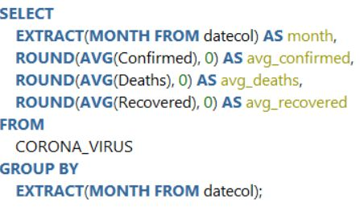
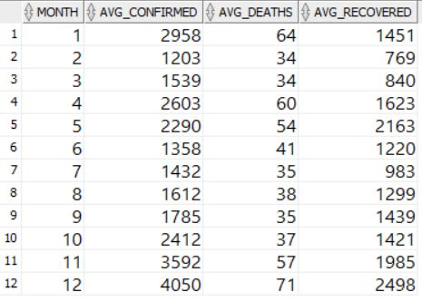
Q6. Find monthly average for confirmed, deaths, recovered

Slide 12
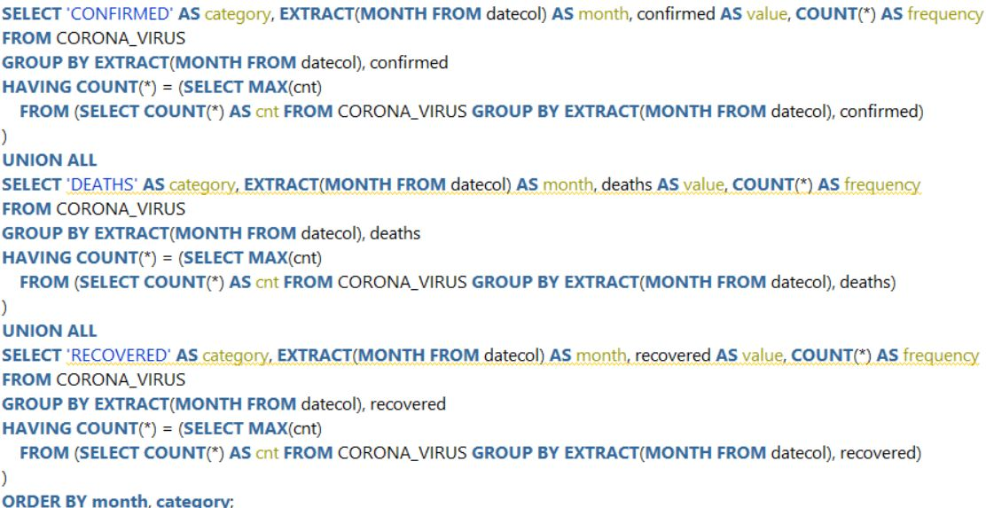
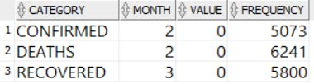
Q7. Find most frequent value for confirmed, deaths, recovered each month

Slide 13
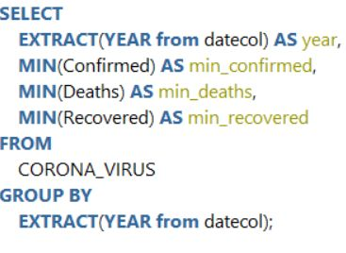

Q8. Find minimum values for confirmed, deaths, recovered per year

Slide 14
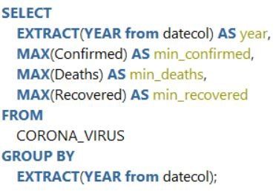

Q9. Find maximum values of confirmed, deaths, recovered per year

Slide 15
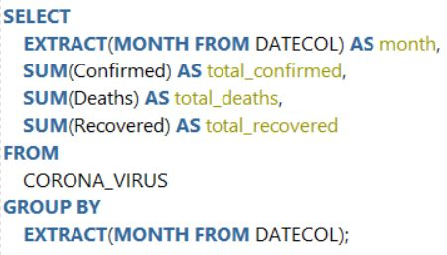
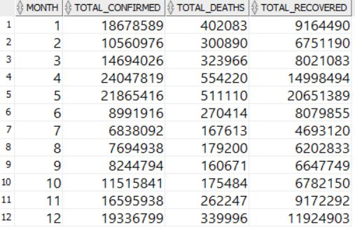
Q10. The total number of case of confirmed, deaths, recovered each month

Slide 16
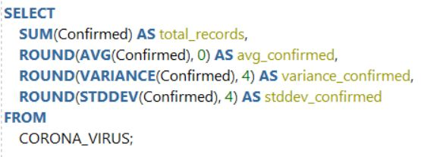
Q11. Check how corona virus spread out with respect to confirmed case

Slide 17
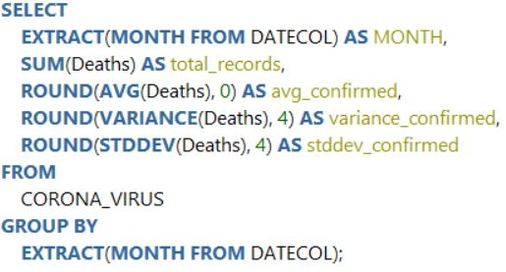
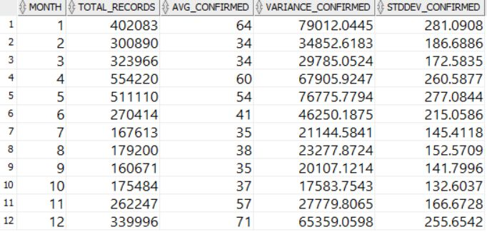
Q12. Check how corona virus spread out with respect to death case per month

Slide 18
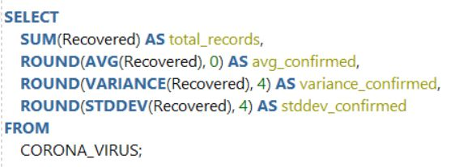
Q13. Check how corona virus spread out with respect to recovered case

Slide 19
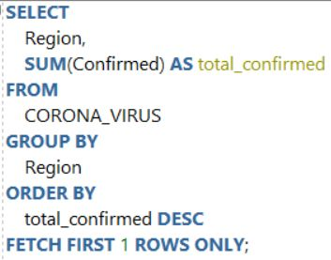

Q14. Find Country having highest number of the Confirmed case

Slide 20
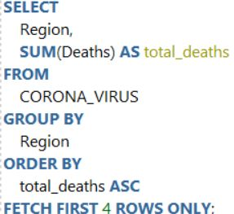
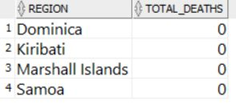
Q15. Find Country having lowest number of the death case

Slide 21
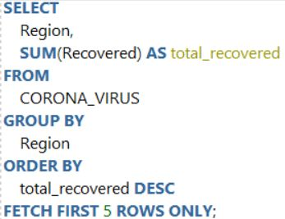
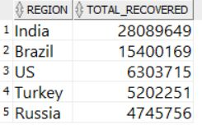
Q16. Find top 5 countries having highest recovered case

Slide 22

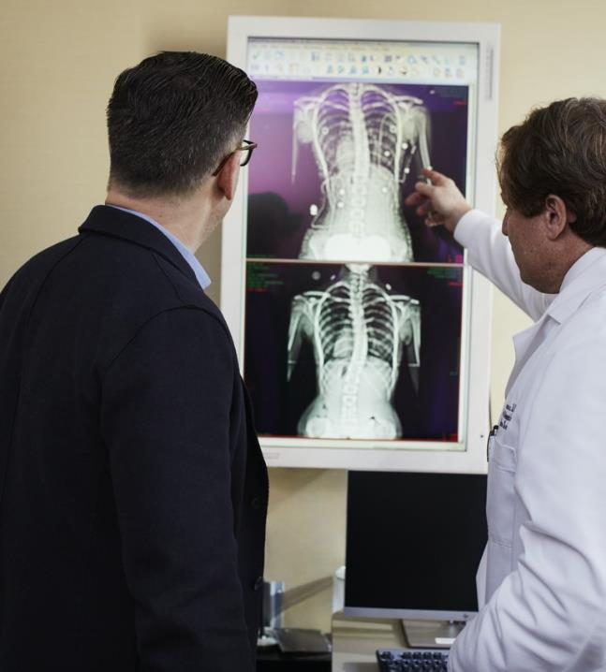
RESULTS & DISCUSSION
From January to March 2020, confirmed cases surged, with the highest peak in February reaching 58,016 cases, indicating critical periods of COVID-19 spread.
The average confirmed cases per month were around 25,698 with a large variance of 604,566,956, highlighting the virus's inconsistent spread and impact.
The US had the highest confirmed cases at 97,028, while China showed the highest recovery rate with 70,420 recovered cases and also had the lowest death count with only 4 cases.
February saw the most significant surges in confirmed and recovered cases, and notable regional differences in responses and outcomes were evident, particularly in the recovery rates.
Notes:
Links:
https://www.pexels.com/photo/doctor-pointing-x-ray-result-beside-man-wearing-black-suit-2182972/

Slide 23


FUTURE SCOPE
Future studies should focus on city-level data to understand localized transmission dynamics and socio-economic factors affecting COVID-19 spread and recovery.
Developing predictive models using historical data can anticipate future outbreaks and case surges, aiding in proactive health measures and resource allocation.
Integrating COVID-19 data with vaccination rates and public health policies will provide a broader view of the pandemic's impact and the effectiveness of different interventions.
Creating interactive and advanced visualization tools will simplify complex data, making it accessible and actionable for decision-makers and the public.
Notes:
Links:
https://pixabay.com/photos/scientist-drugstore-microscope-2141259/

Slide 24


CONCLUSION
The analysis revealed critical periods of the pandemic, particularly in February 2020, and highlighted key trends in the spread and impact of COVID-19.
The insights underscore the importance of data-driven strategies in guiding public health responses and decision-making processes during health crises.
SQL and data analysis techniques were crucial in uncovering meaningful patterns in the dataset, demonstrating their value in real-world problem-solving.
Continued data collection and analysis are essential for tracking the evolving dynamics of COVID-19 and preparing for future health challenges.
This Photo by Unknown Author is licensed under CC BY-NC-ND
Notes:
Links:
https://www.pexels.com/photo/surgeon-in-the-operating-room-3845127/
https://www.pexels.com/photo/photo-of-woman-wearing-stethoscope-3408367/
https://www.pexels.com/photo/young-woman-holding-a-stethoscope-3758765/
https://www.pexels.com/photo/woman-discussing-a-lesson-3758869/

Slide 25
THANK YOU

